Slide 1
Objective
Why microservice?
Microservice Definition
Benefits of microservice
SR Create - Existing Design
SR Create - Microservice Design
Deployment Architecture - Kubernetes cluster
Benefits

Slide 2
Why Microservice?
What are the most common pain points in monolithic application?
Too Complex
No Specialization
Apps get too big and complicated for a developer to understand over time. Hence difficult to manage
Different parts of applications have different needs – more CPU, more memory, faster network, etc.
Too Complex
No
Specialization
Too Slow
No Ownership
Teams split up by function – UI, Application, Middleware, database, etc.
Too
Slow
No
Ownership
Code falls victim to “tragedy of the commons” – when there’s little ownership, you see neglect
Too Fragile
Inefficient
Testing
Too Fragile
Inefficient Testing
A bug will quickly bring down an entire application. Little resiliency
Each change requires a complete testing cycle. Hard to support continuous delivery

Slide 3
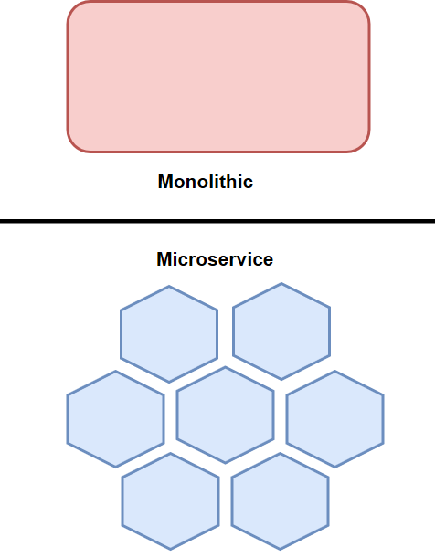
Microservice Definition
The microservice architectural style is an approach to developing a single application as a suite of small services, each running in its own process and communicating with lightweight mechanisms, often an HTTP resource API
Small autonomous piece of code which do one thing and do one thing very well.
Technology agnostic - Service can be written in different language and framework.
It design, develop and deploy independently. Not sharing any resources and it run in its own process.
It have own independent delivery pipeline.

Slide 4
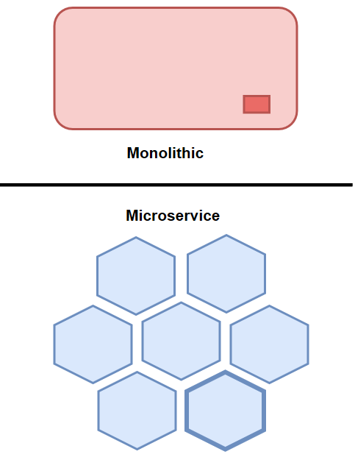
Benefits of Microservice
Auto scaling – Allow performance critical components to scale independently from the rest of the system
Risk reduction - Update and deploy only the parts that need to be changed, not the entire system. Enable powerful deployment patterns like canary deployments and green-blue deployments
Resilient systems – Failures in a component don’t necessarily affect the rest of the application.
Flexibility – As loosely coupled components, microservices can be implemented using different technologies and platforms, if needed, depending on requirements.
Fast release - Less to build, deploy, and test per each release since changes do not touch the entire system
Cost effective deployment – CPU intensive and memory intensive services can be deployed on different type of hardware.

Slide 5
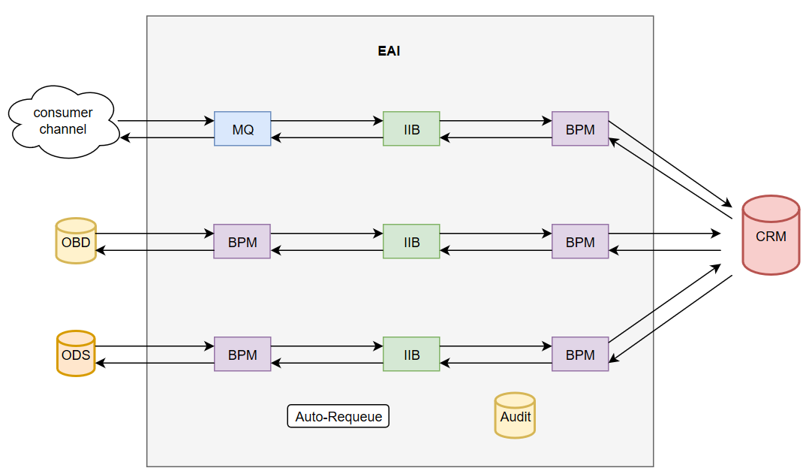
SR Create – Existing Design
Total ears : 45
2 OBD inbound
10 ODS inbound
33 CRM outbound
Total flow : 6
3 Request flow
3 Response flow
Total Queue : 97

Slide 6
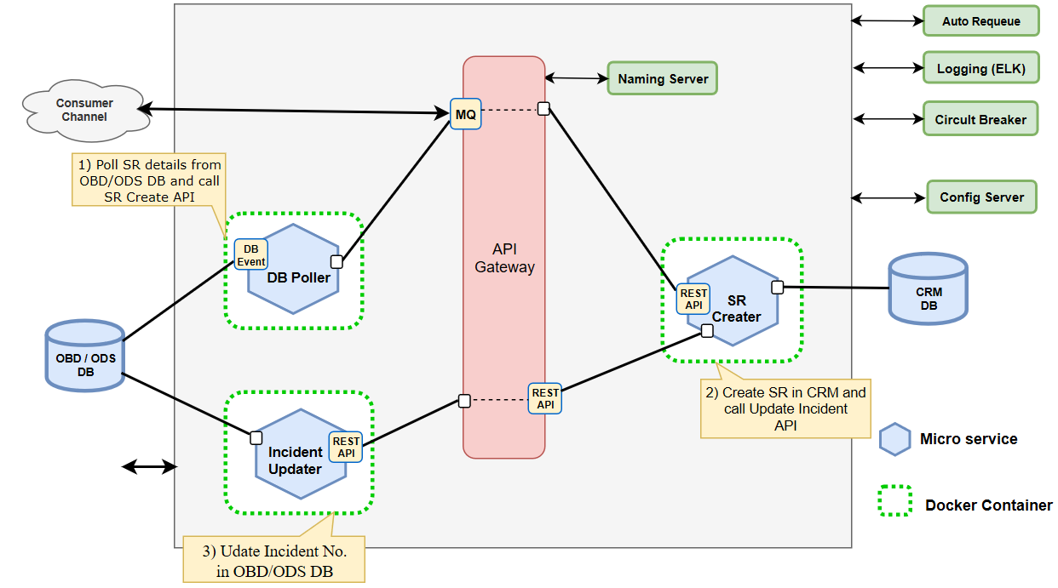
SR Create – Micro Service Design

Slide 7
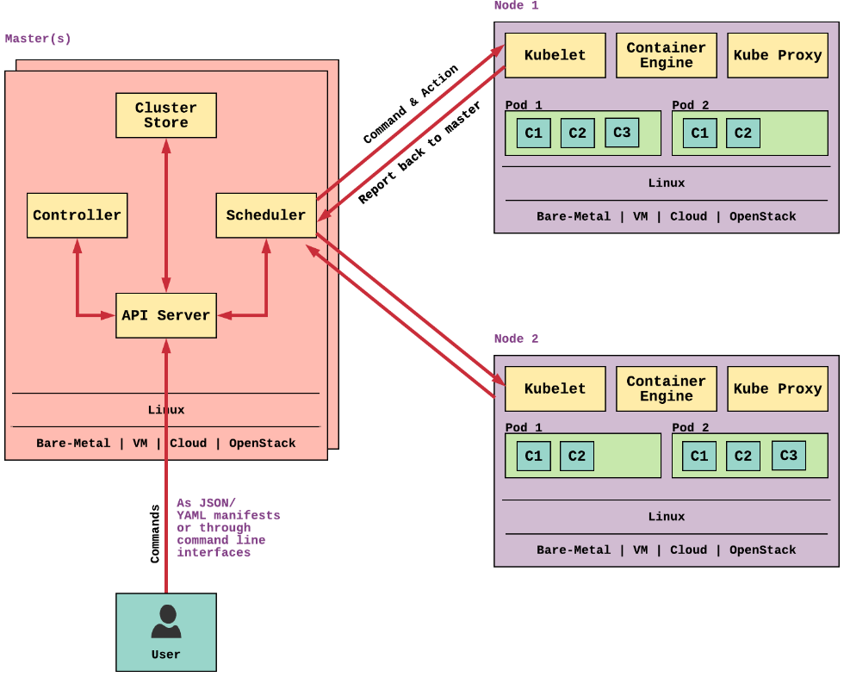
Deployment Architecture - Kubernetes cluster
Master is the controlling element of the cluster. It is the “Brain" of the cluster. For the purpose of fault-tolerance, one cluster may have multiple masters.
API server is the front end that communicates with user. It use REST-based API or CLI to command to communicate.
Scheduler watches API server for new Pod requests. It communicates with Nodes to create new pods and to assign work to nodes
Cluster store is a persistent storage holding cluster states and configuration details. It uses ETCD (open-source distributed key-value store) to store these data.
Controller - Includes Node controller, Endpoint Controller, Namespace Controller, etc.
Kubelet register the nodes with the cluster, watches for work assignments from the scheduler, instantiate new Pods, report back to the master, etc.
Container Engine does all the image pulling, container stopping, starting, etc. Most widely used container engine is Docker
Kube Proxy is responsible for assigning IP addresses per pod. Each time a pod creates, a new IP address will be allocated for that pod. Kube Proxy also does the Loadbalancing work.

Slide 8
Benefits
Scalability and Flexibility
IIB and BPM licenses cost saving
Reduction in ??? Core ( ? Need to calculate exact figure)
Introduction of Microservice Architecture in Account
Better fault Isolation

Slide 9
Thank you

